Slide 1
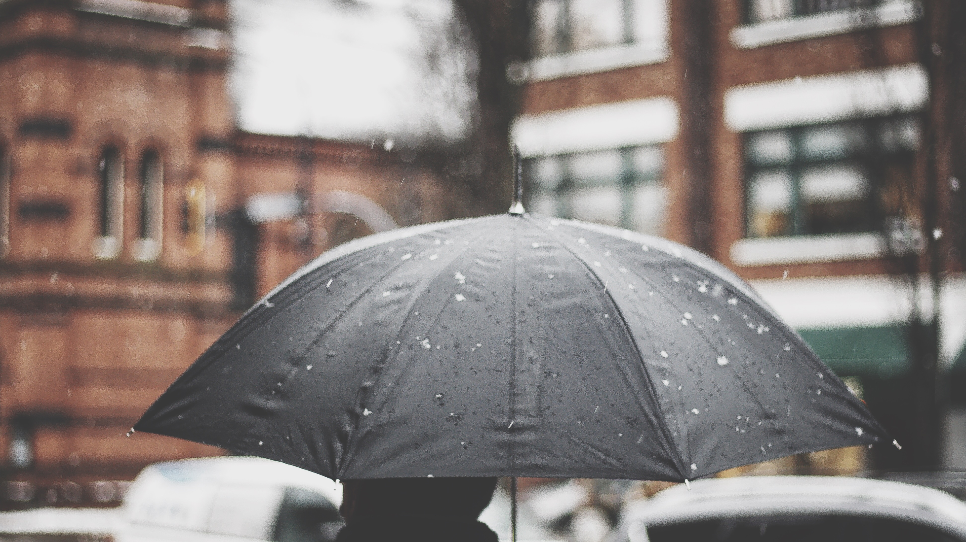
Crime Rate in relation to Weather in Atlanta
Can weather patterns be used to predict crime?

Slide 2

Presented by: The Crime Ninjas
Gary Groscost
Prudhvi Krishna Sannapareddy
Pradip Raodeo
Steven Rufus
Emmanuel Yoacel Okecha
Hwa Hara
James Dellinger
Kafayat Lawal
Megan Harper
Michael Damas

Slide 3
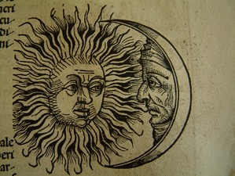
Background Information
Heat Hypothesis:
“The heat hypothesis states that hot temperatures can increase aggressive motives and behaviors”
Craig A Anderson – Dept. of Psychology, Iowa State University, Ames, Iowa
“Violent crime rates rose, on average, 5.7% on days when the temperature was above 85 degrees.”
Kilian Heilmann & Matthew E. Kahn – Dept. of Economics, University of Southern California, Los Angeles, California
Moon Phases and Behavior
” But now, my lord. It is the very error of the moon; She comes more nearer earth than she was wont, And makes men mad.”
Othello – William Shakespeare
81% of mental health workers claim a relationship between human illness and a full moon
Francis OJ, Kopke BJ, Affatato AJ, Jarski RW. Psychiatric Presentations During All 4 Phases of the Lunar Cycle.

Slide 4
Background Info Cont.
Part 1 Offenses
Serious crimes that occur on a regular basis and are likely to be reported to law enforcement
Standardized under the FBI Uniform Crime Reporting guidelines
Part 1 offenses used in our dataset and analysis
Aggravated Assault
Auto Theft
Nonresidential Burglary
Residential Burglary
Homicide
Vehicle Larceny
Non-Vehicle Larceny
Rape
Residential Robbery
Pedestrian Robbery
Commercial Robbery

Slide 5

Research Questions
Do certain weather conditions influence the volume of part 1 offenses in Atlanta, GA?
Do certain weather conditions influence the type of part 1 offenses committed in Atlanta, GA?
Does the Moon phase influence the volume or type of part 1 offenses in Atlanta, GA?
Can we predict the rate of part 1 offenses committed in Atlanta, GA using a linear regression model?

Slide 6
Data Visualization

Slide 7
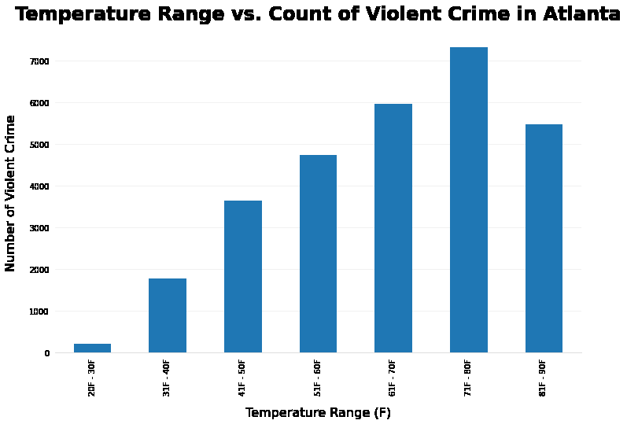
Temperature in relation to crime
Highest crime count occurs between 71-80 degree weather
Crime is at its lowest in below freezing tempreatures

Slide 8
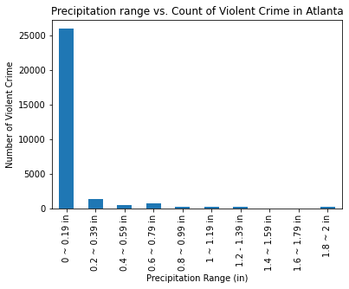
Precipitation in relation to crime
Highest crime counts occur in the smallest rain range 0-.19 inches.
This is contrary to pop culture depictions of crimes occurring during rainy/stormy weather
We can conclude that the “nicer” the weather, the more crimes occur.

Slide 9
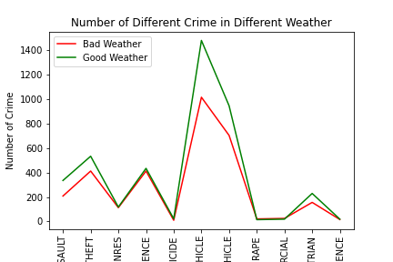
Good weather vs Bad weather
Bad Weather
Less than 50 more than 80 degrees
Precipitation greater than zero
Good Weather
More than 65 less than 75
Precipitation equals 0 inches
Homicides up by ~120%
10 Homicides bad weather vs 22 on good weather

Slide 10
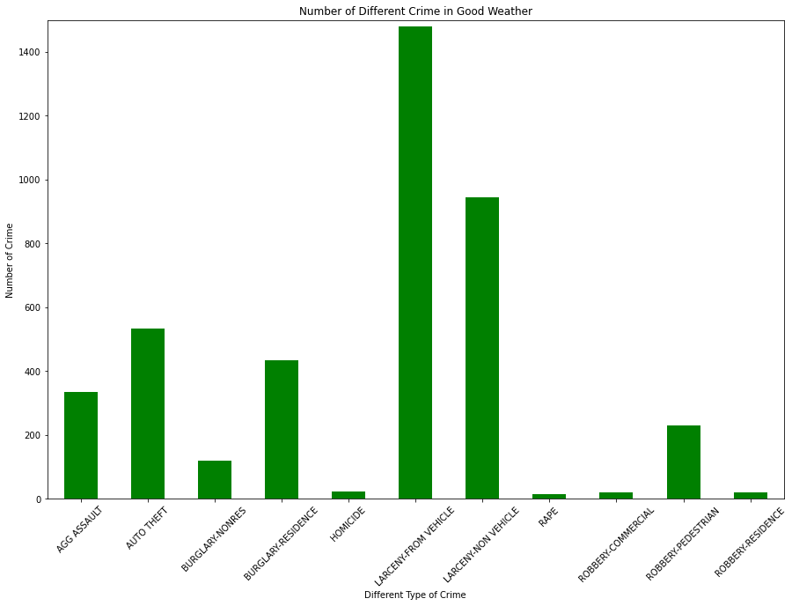
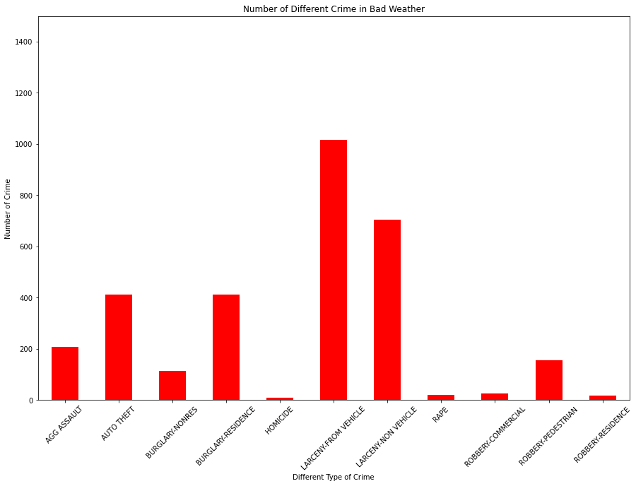
Good Weather VS Bad Weather

Slide 11
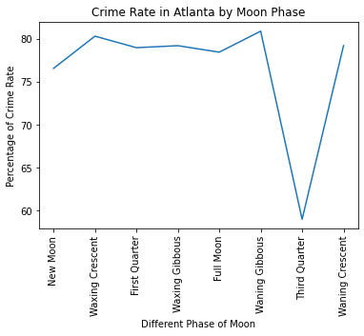
Moon phases in relation to crime
During third quarter moon, dip in crime
We cannot conclude that Full moon has any affect on crime

Slide 12
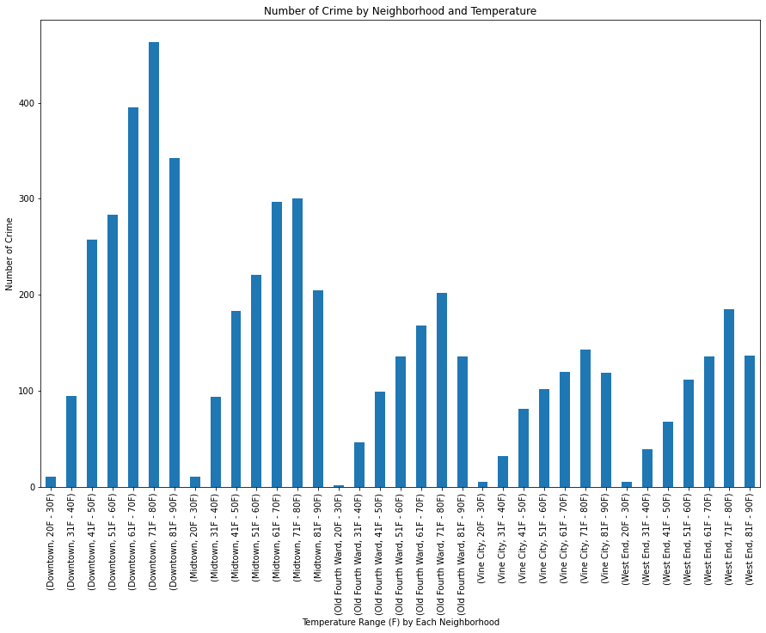
Crime data broken down by neighborhood

Slide 13
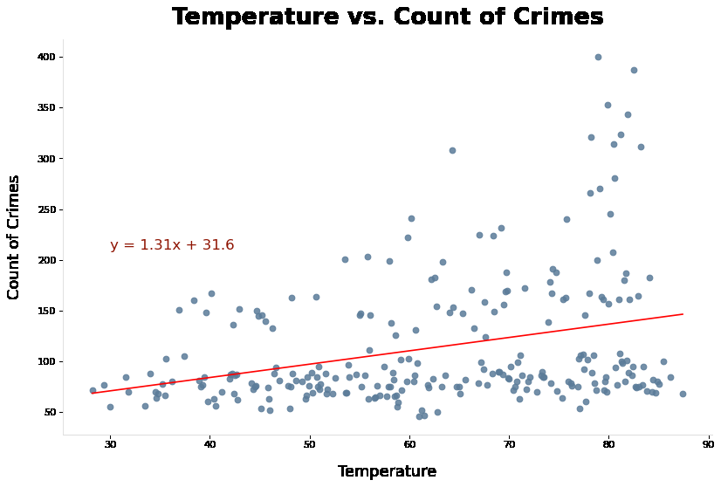
Predication model based on Weather

Slide 14
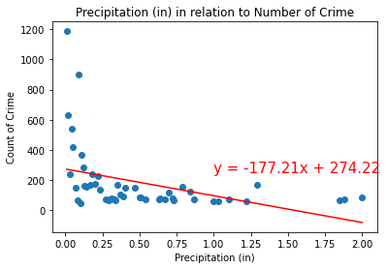
Prediction model based on Precipitation

Slide 15
Conclusions

Slide 16
Limitations
-Atlanta Weather is not broken down by neighborhood while crime type is broken down by neighborhood

